Slide 1
Sprint #2
By Team [Hip, Hip]: Jack, Alea, Davis, and Elizabeth

Slide 2
Overview
Fixing/planning/extension of elements discussed in Sprint #1
Further user story implementation
Database implementation
We will be talking about…

Slide 3
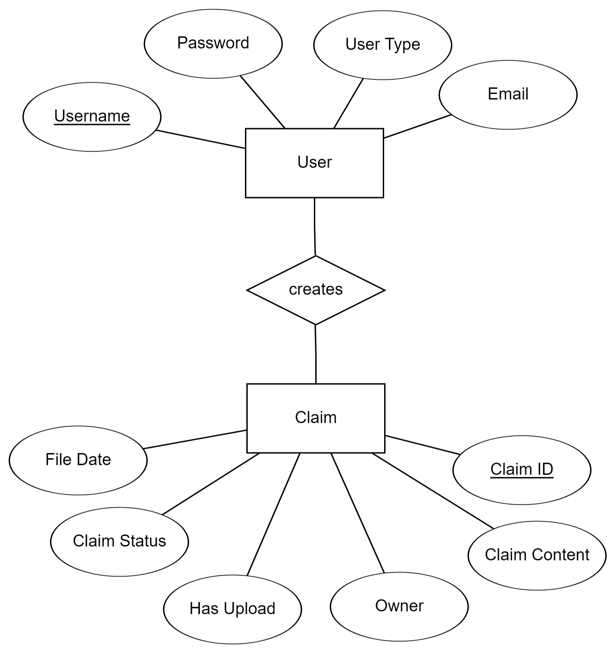
Updated ERD
realized our original ERD was more complex than we needed it to be
decided to define each user’s type by which specific character their username begins with
claim IDs will be strings of integers that increment up with each new claim generated
this ERD appears to be working for our system for the time being, but we will complexify / simplify it further as we need to and keep track of our updates to it
this model of a database appears to be working smoothly with the SQL database we deployed from our last sprint + is much easier for the back-end people to manage

Slide 4
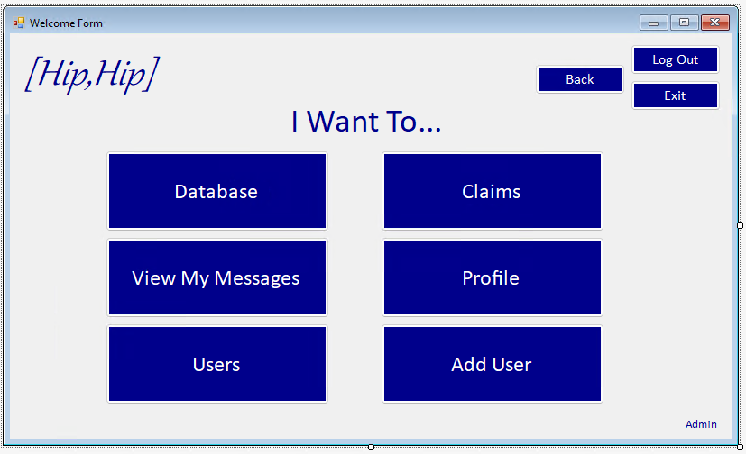
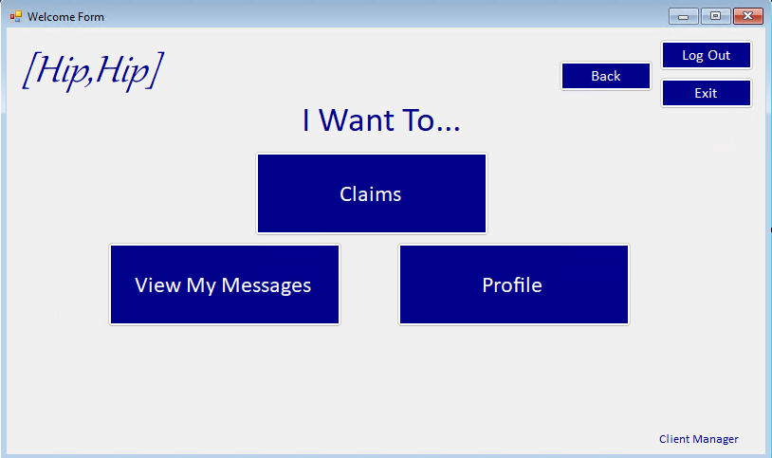
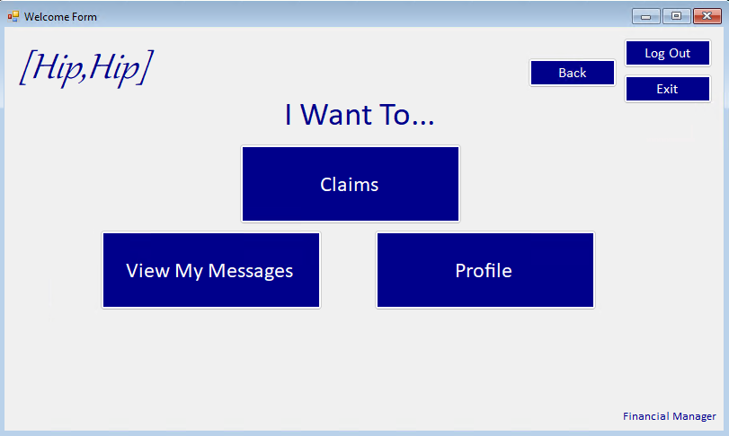
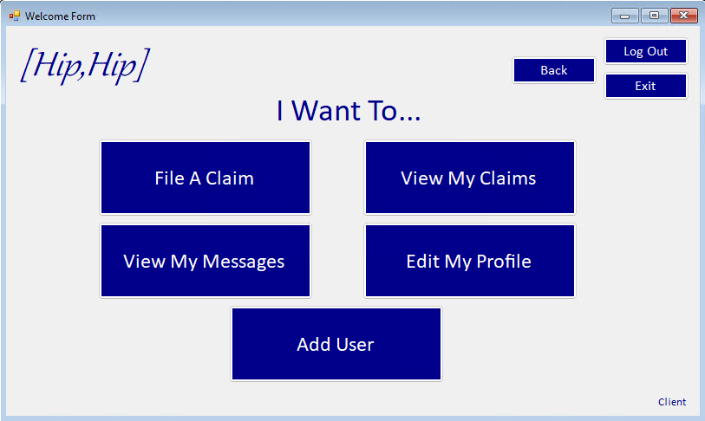
User’s Homepage

Slide 5
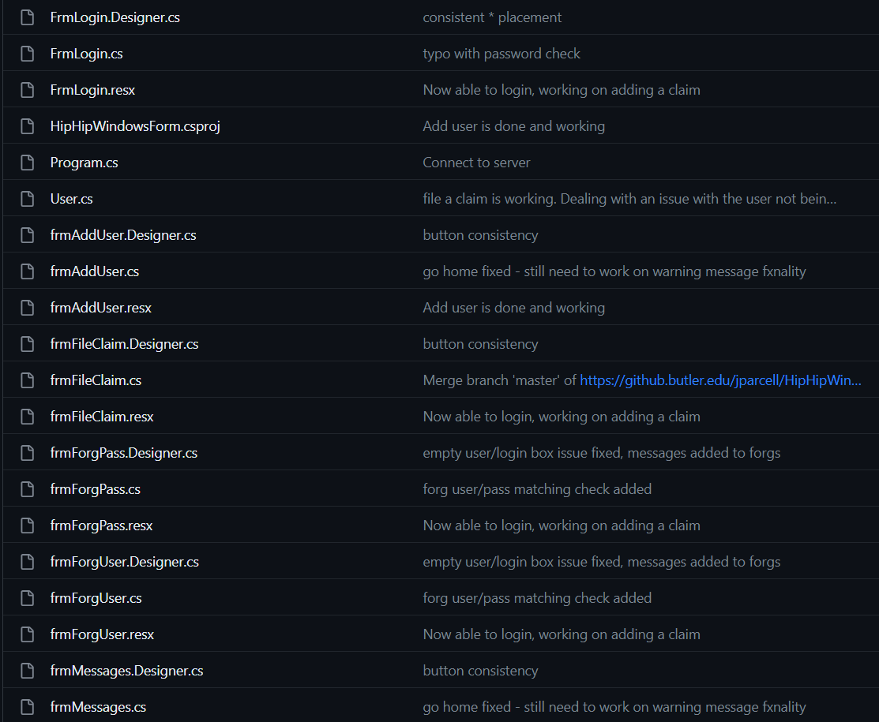
Fixed Form Naming Conventions
Made everything consistent across the board

Slide 6
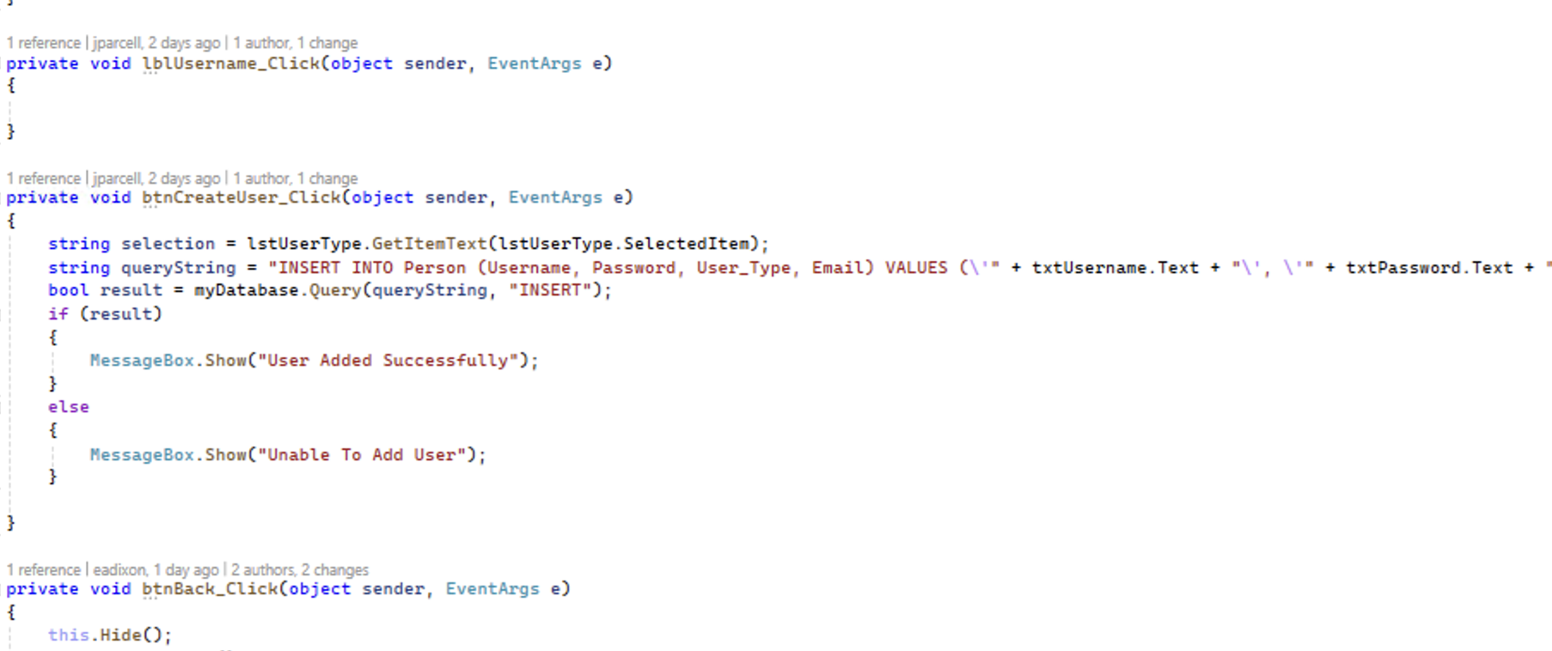
Query String Code Examples
Notes:
Query string is generated inside respective form, and then passed into the database class along with an identifier that determines what should be returned.

Slide 7
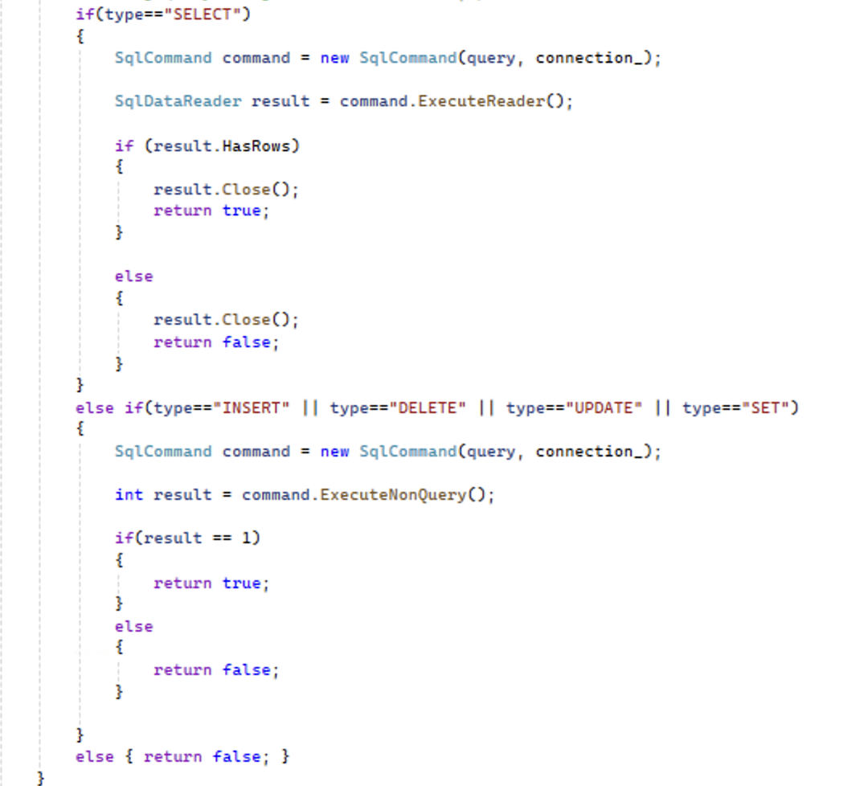
SqlCommand Code Examples
Separates what should be returned
Will have to determine a solution for when we want an actual value returned from a query

Slide 8
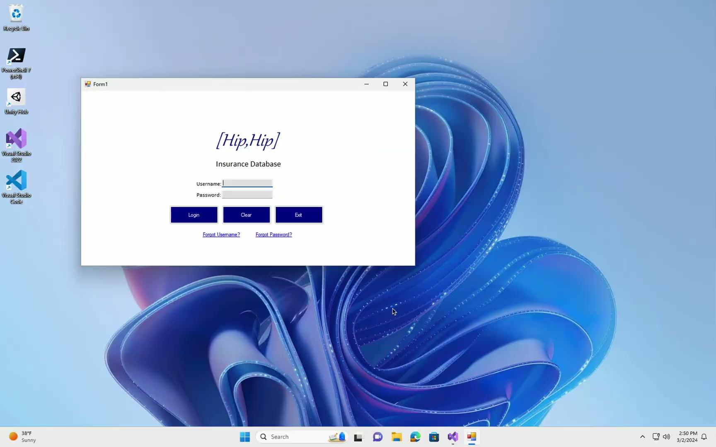
Login and File Claim Demo

Slide 9
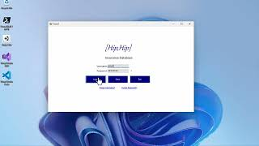
Login Check Demo

Slide 10
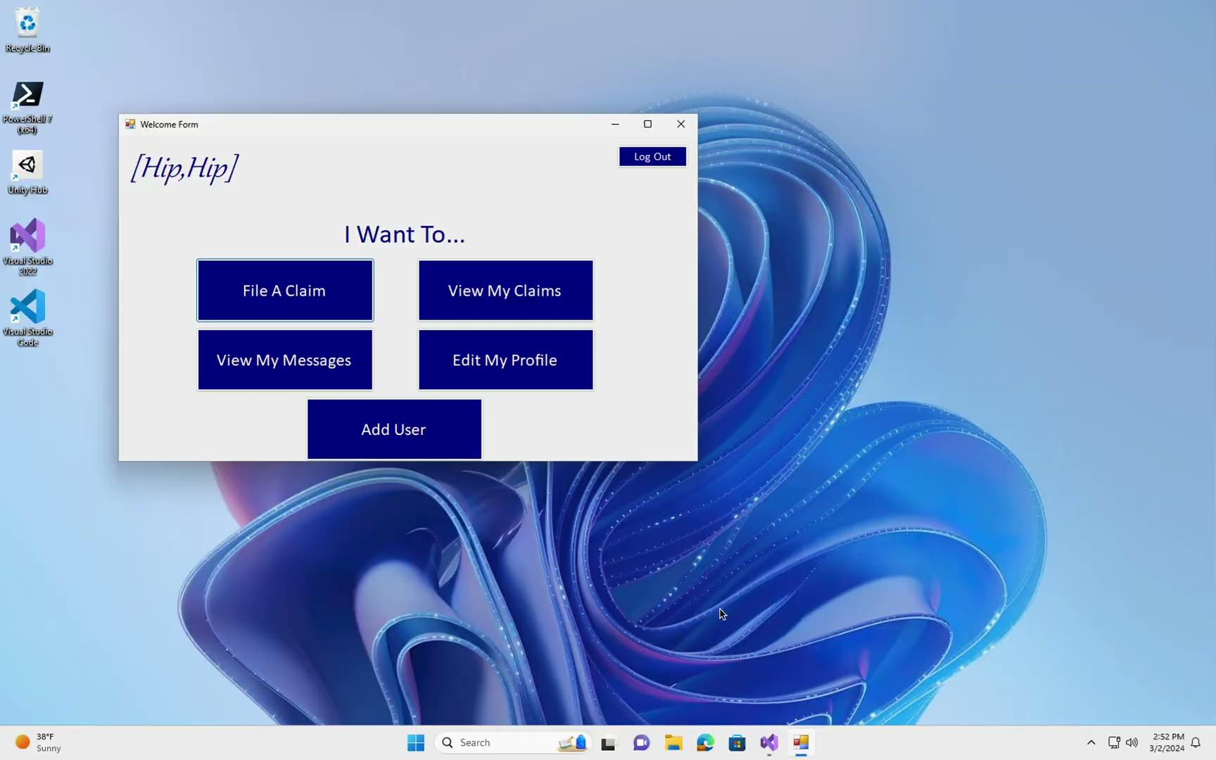
Add User Demo

Slide 11
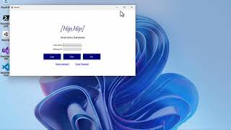
Basic Forgot Username/Password Demo

Slide 12
Challenges
Making sure everything was consistent after database implementation
re-initializing/defining parameters for previously established objects

Slide 13
What's Next?
Implement back buttons universally
Not hardcoding
Attach database to forgot username/password forms
Check if the email already exists, if a password is already used by someone else, etc.
Further attach database to submissions (etc.) so that the "work saved" is more practical
Ideas for Sprint #3…

